Slide 1
Introduction to DBMS

Slide 2
Agenda
Introduction to DBMS & its Architecture
File System & its Disadvantages.
Introduction to DBMS
DBMS definition.
Advantages.

Slide 3
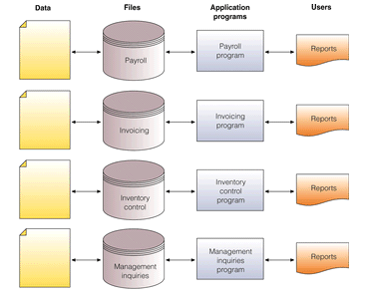
The Traditional Approach To Data Management
Create new files for each application
Data redundancy
Data integrity

Slide 4
Disadvantages of File Processing
Program-Data Dependence
All programs maintain metadata for each file they use
Data Redundancy (Duplication of data)
Different systems/programs have separate copies of the same data
Limited Data Sharing
No centralized control of data
Lengthy Development Times
Programmers must design their own file formats
Excessive Program Maintenance
80% of information systems budget

Slide 5
DATABASE Definition
Data : These are the known facts that can recorded and that have implicit meaning
Ex : item codes , book titles, phone numbers etc.
Database : It is a collection of related data
Ex : names , telephone numbers, addresses, age etc.

Slide 6
DBMS Definition
It is a general purpose software system that facilitates the processes of:
Defining
Constructing
Manipulating
Sharing
databases among various users and applications.

Slide 7
DBMS Definition Contd..
Defining : It involves specifying data types, structures and constraints for the data to be stored in the database.
Constructing : It is the process of storing the data itself on some storage medium that is controlled by DBMS.
Manipulating : It includes functions such as querying the database to retrieve specific data , updating the database to reflect changes in mini world and generating reports from the data.
Sharing : It allows multiple users and programs to access the database concurrently.

Slide 8
Advantages of DBMS
Controlling redundancy.
Reduce Inconsistency.
Providing storage structure for efficient query processing.
Restricting unauthorized users.
Providing concurrency.
Providing backup and recovery.
Enforcing integrity constraints.

Slide 9
Database terminology
Schema
.
Database Schema
The description of a database.
Includes descriptions of the database structure.
data types and the constraints on the database.
Schema Diagram
An illustrative display of (most aspects of)database schema
Schema Construct
A component of the schema or an object within the schema.
e.g., STUDENT, COURSE
Database State
Refers to the content of a database at a moment In time.
Initial Database State
Refers to the database state when it is initially loaded into the system.
Valid State
A state that satisfies the structure and constraints of the database.

Slide 10
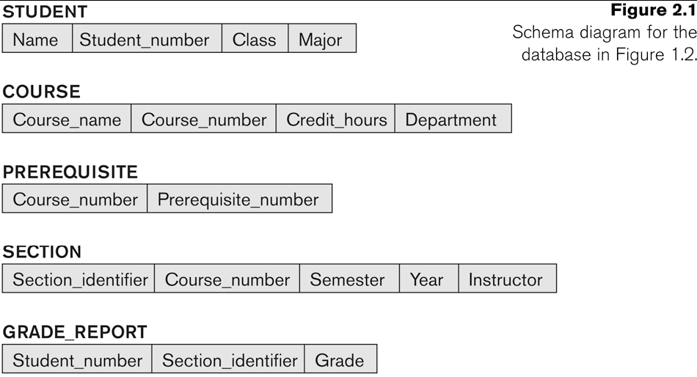

Slide 11
Database terminology
Database State
The actual data stored in a database at a particular moment in time. This includes the collection of all the data in the database.
Also called database instance (or occurrence or snapshot).
The term instance is also applied to individual database components, e.g. record instance, table instance, entity instance
Distinction
The database schema changes very infrequently.
The database state changes every time the database is updated.
Schema is also called intension.
State is also called extension

Slide 12
3 schema Architecture
Proposed to support DBMS characteristics of:
Program-data independence.
Support of multiple views of the data.
Not explicitly used in commercial DBMS products, but has been useful in explaining database system organization

Slide 13
3 schema Architecture Contd..
Defines DBMS schemas at three levels:
Internal schema at the internal level to describe physical storage structures and access paths (e.g. indexes).
Typically uses a physical data model.
Conceptual schema at the conceptual level to describe the structure and constraints for the whole database for a community of users.
uses a conceptual or an implementation data model.
External schemas at the external level to describe the various user views.
Usually uses the same data model as the conceptual schema.

Slide 14
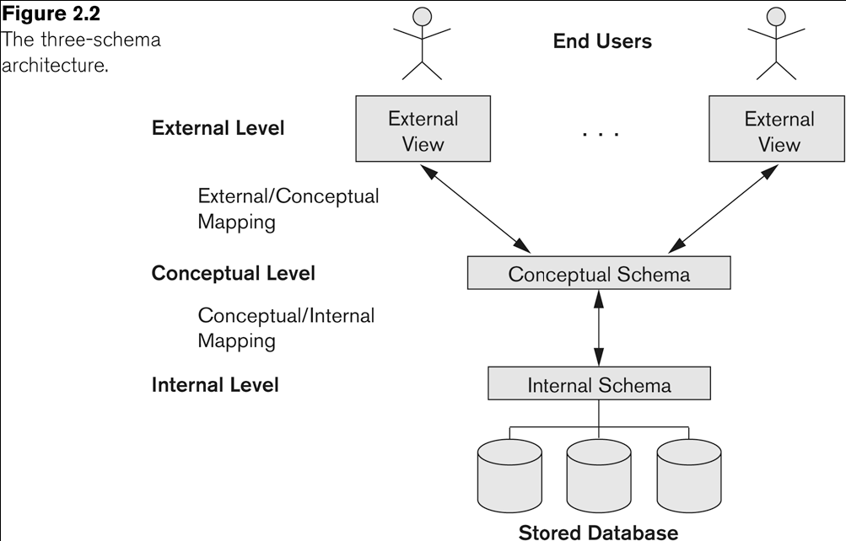
3 schema Architecture Contd..

Slide 15
3 schema Architecture Contd..
Mappings among schema levels are needed to transform requests and data.
Programs refer to an external schema, and are mapped by the DBMS to the internal schema for execution.
Data extracted from the internal DBMS level is reformatted to match the user’s external view (e.g. formatting the results of an SQL query for display in a Web page)

Slide 16
Data Independence
Logical Data Independence:
The capacity to change the conceptual schema without having to change the external schemas and their associated application programs.
Physical Data Independence:
The capacity to change the internal schema without having to change the conceptual schema.
For example, the internal schema may be changed when certain file structures are reorganized or new indexes are created to improve database performance

Slide 17
Thank you
Visit us at www.techmahindra.com
Disclaimer
Tech Mahindra Limited, herein referred to as TechM provide a wide array of presentations and reports, with the contributions of various professionals. These presentations and reports are for informational purposes and private circulation only and do not constitute an offer to buy or sell any securities mentioned therein. They do not purport to be a complete description of the markets conditions or developments referred to in the material. While utmost care has been taken in preparing the above, we claim no responsibility for their accuracy. We shall not be liable for any direct or indirect losses arising from the use thereof and the viewers are requested to use the information contained herein at their own risk. These presentations and reports should not be reproduced, re-circulated, published in any media, website or otherwise, in any form or manner, in part or as a whole, without the express consent in writing of TechM or its subsidiaries. Any unauthorized use, disclosure or public dissemination of information contained herein is prohibited. Unless specifically noted, TechM is not responsible for the content of these presentations and/or the opinions of the presenters. Individual situations and local practices and standards may vary, so viewers and others utilizing information contained within a presentation are free to adopt differing standards and approaches as they see fit. You may not repackage or sell the presentation. Products and names mentioned in materials or presentations are the property of their respective owners and the mention of them does not constitute an endorsement by TechM. Information contained in a presentation hosted or promoted by TechM is provided “as is” without warranty of any kind, either expressed or implied, including any warranty of merchantability or fitness for a particular purpose. TechM assumes no liability or responsibility for the contents of a presentation or the opinions expressed by the presenters. All expressions of opinion are subject to change without notice.

